Slide 1

Senior Design Project by: Katie Canedo, Alexis Haley, Aveisha Maharaj, Marko Vukasinovic, and Kayla Mastin
Milestone 3

Slide 2
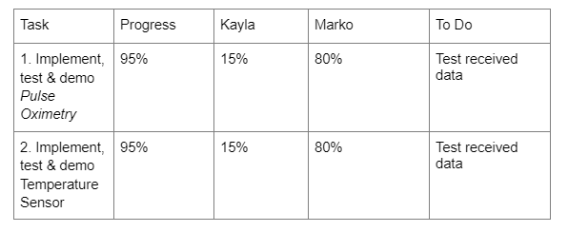
General Updates
Waiting for materials to come in - Orders were finally placed

Slide 3
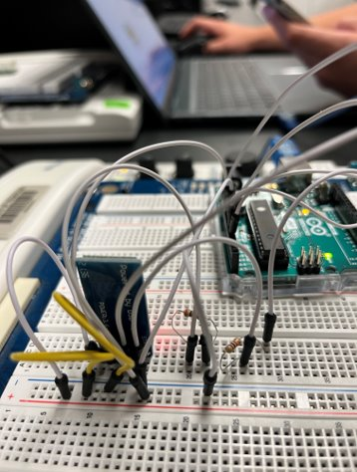
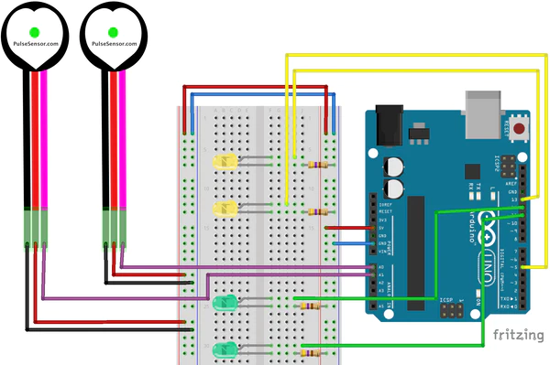
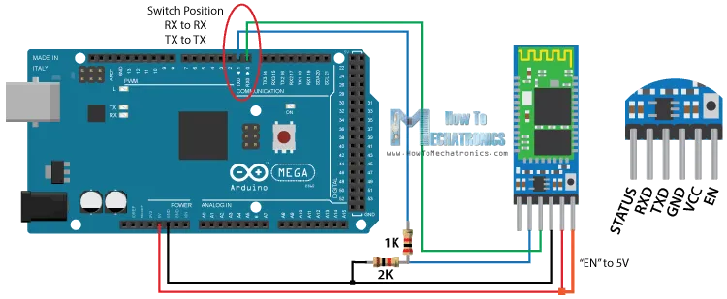
Sensor
Heart Sensor
Built ✔
Modeled layout ✔
Build sensing pad
Validation of numbers (Smart Watch)
Pressure Mapping
Modeled layout ✔
Building
Testing
Heat Sensor
Modeled layout ✔
Building ✔
Testing
Heated Elements
Modeled Layout ✔
Building
Testing

Slide 4
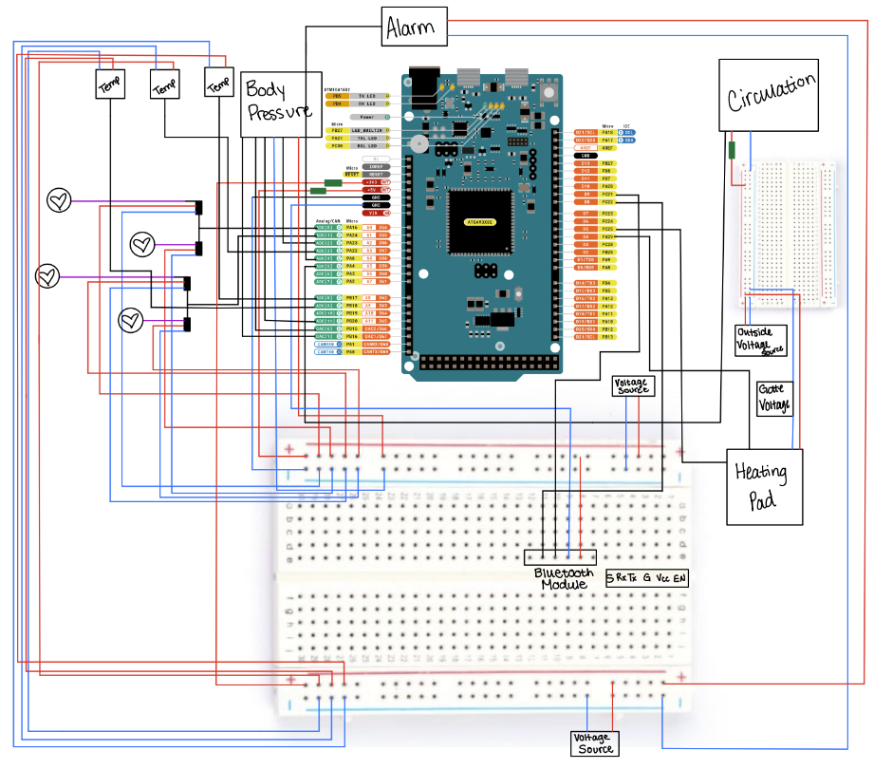
Circuit Diagram

Slide 5
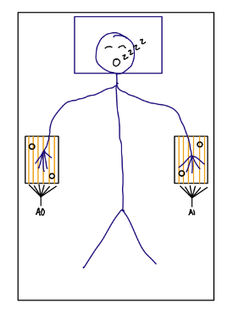
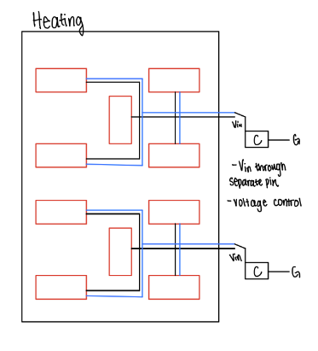
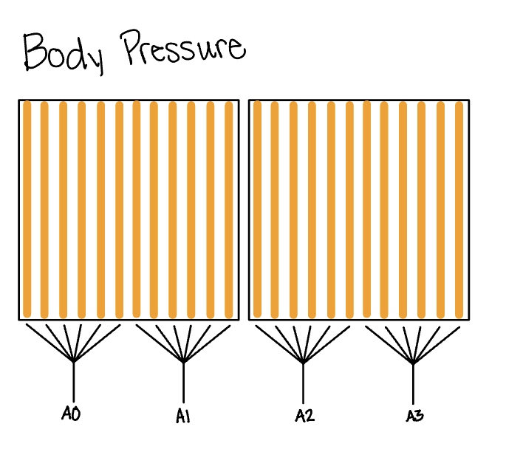
Circuit Diagram

Slide 6
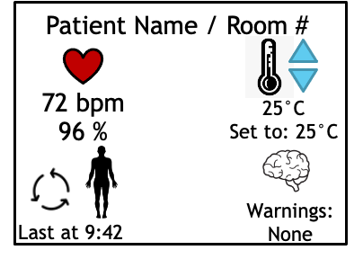

Software
Created App UI
Created a Bluetooth management library in App based on CoreBluetooth
Used library to establish Central Manager in the app to receive signals
Established peripheral commands to find, analyze and communicate with correct service of BLE module
App receives and processes data every 100ms
To do: Compare data with Smart Watch
Notes:
marko

Slide 7
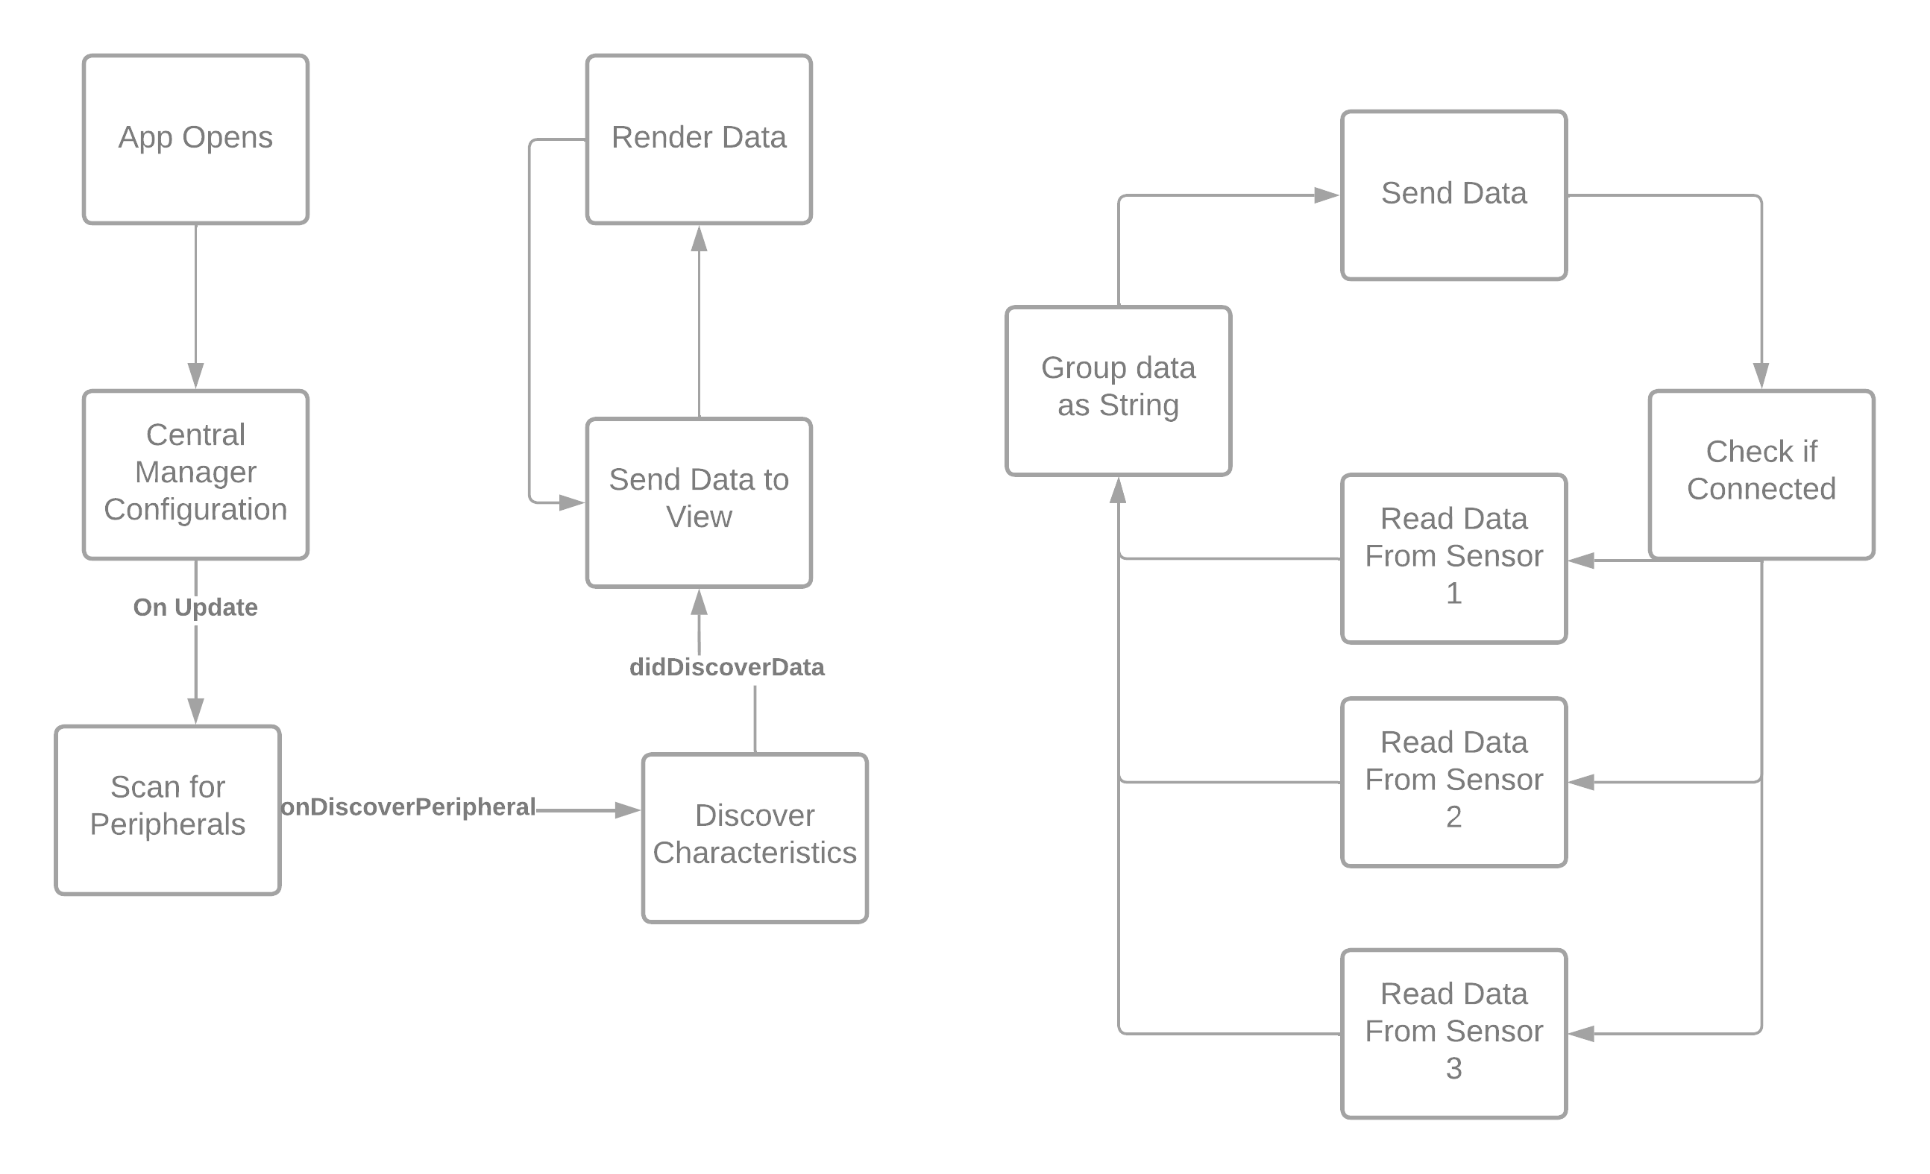

Slide 8
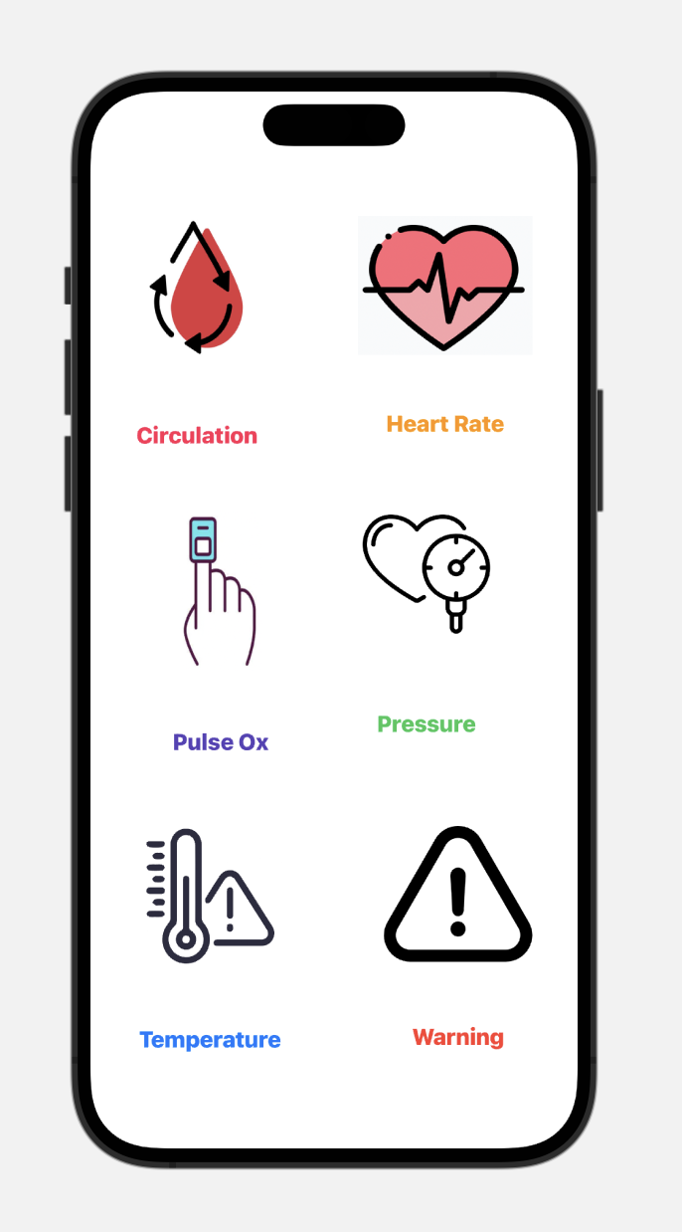
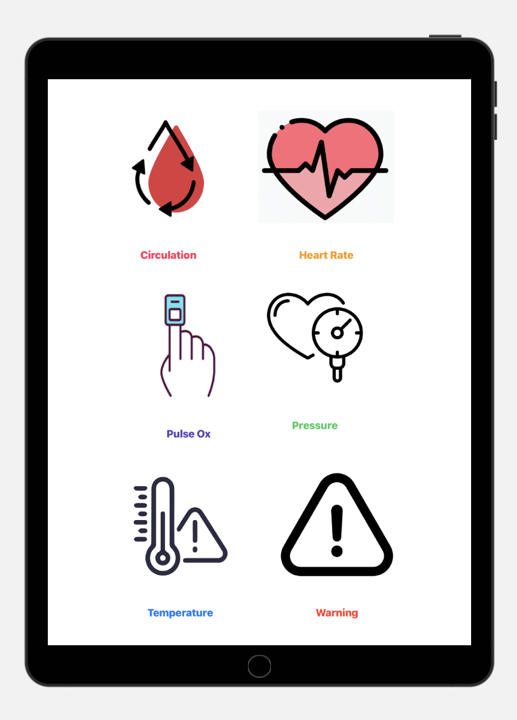
iPhone
iPad

Slide 9
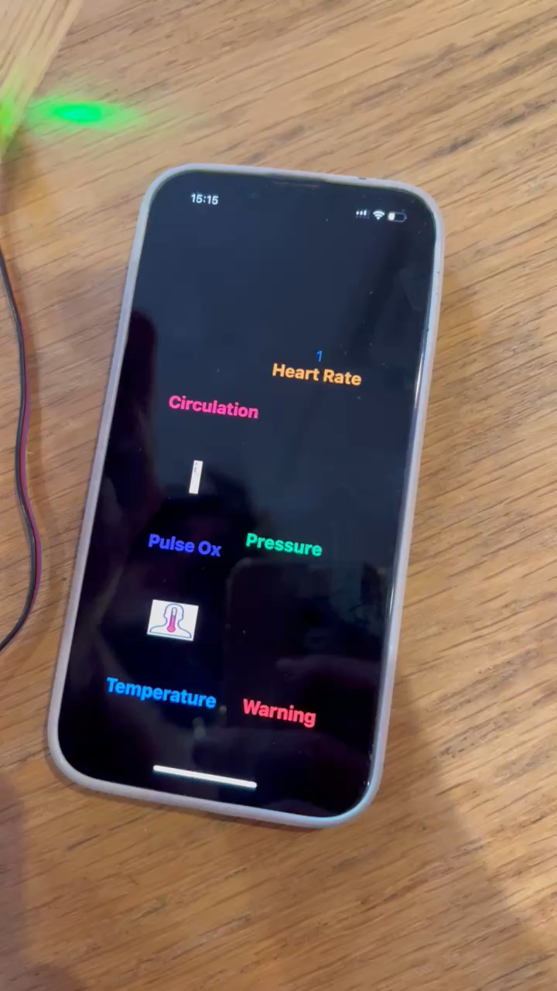

Slide 10

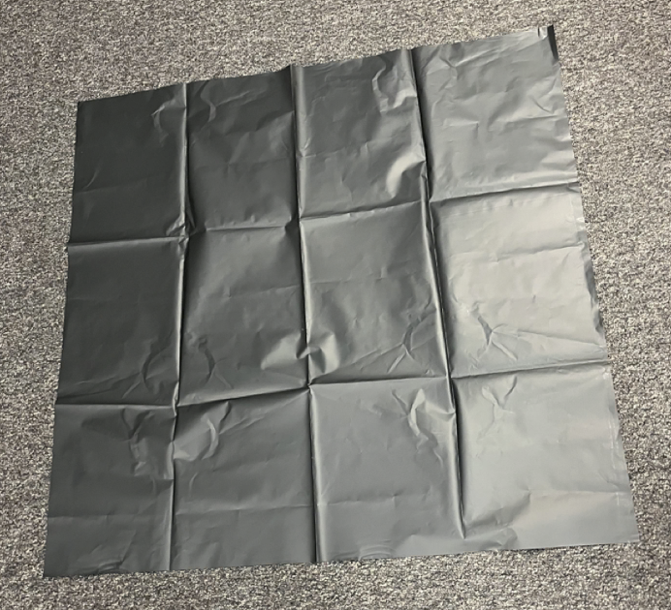
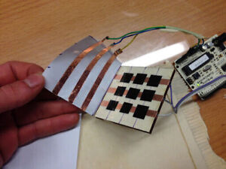
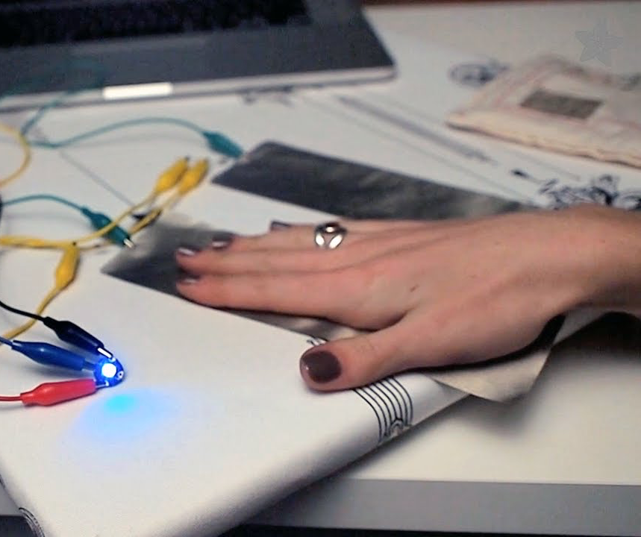
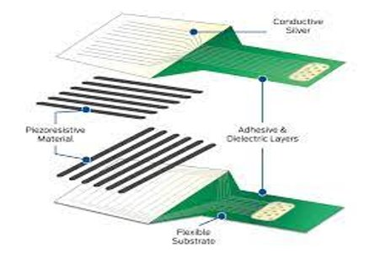
Sensors
Body Pressure Sensor
Sheets are large enough to cover mattress
Add strips of copper on underside
Connect to wiring at the base, then to Arduino
Heart Rate Sensor
Modeled after treadmill
Use conductive fabric joined with 2-4 pulse sensors
Decided to use copper wiring

Slide 11
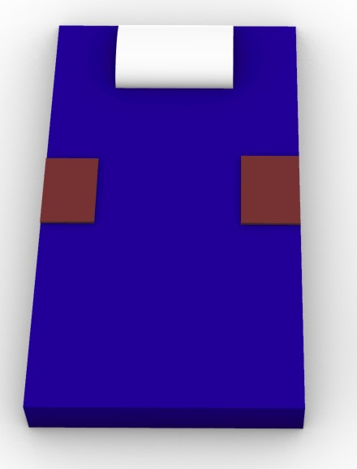
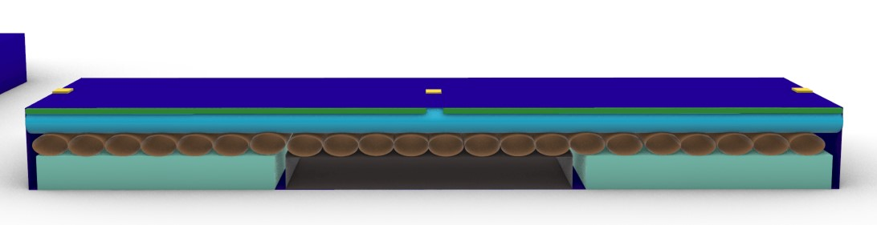
Better Model
Pillow
Temperature Sensor
Pressure Pads
Mattress Exterior
Foam
3D Printed Compartment for Circuitry
Pumps
(Massage, Bed Sores, Clots)
Heating/Cooling Elements
Heart Rate/ Pulse Ox
** Alarm will be connected in app based on pressure, and on metal bed frame if we have time **

Slide 12
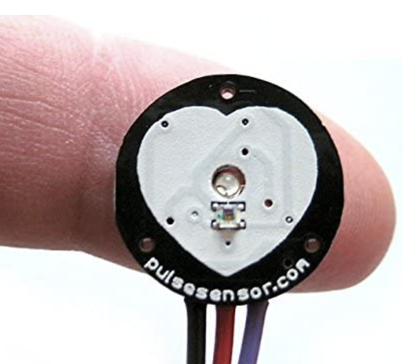
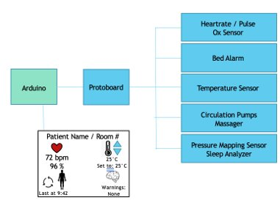
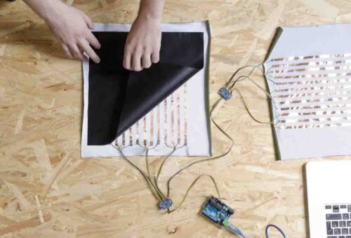
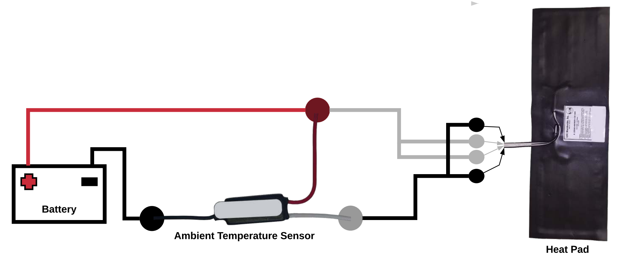
Confirmed Circuits
Heartbeat / Pulse Ox Sensor
Pad Sensor
create our own pad sensor composed of multiple single sensors
Temperature Sensors
Ambient Temperature Sensor for heating
Notes:
aveisha

Slide 13
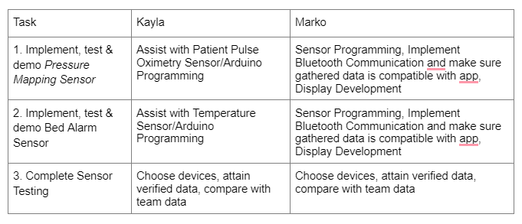

Slide 14



Next Steps
Next Team Meeting Monday at 5 pm
Tuesday at 2pm
Test and Demo The Remaining Sensors
Build heart rate pad
Build pressure sensing pad
Fix Noise Issues
Implement Remaining Sensors
Notes:
Alexis

